Slide 1
Section 5.1 Integrals

Slide 2
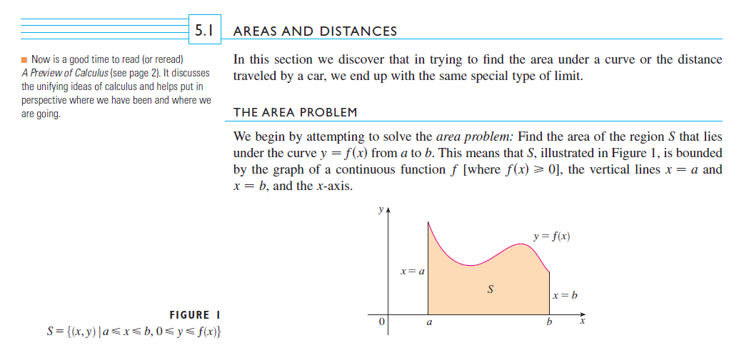

Slide 3
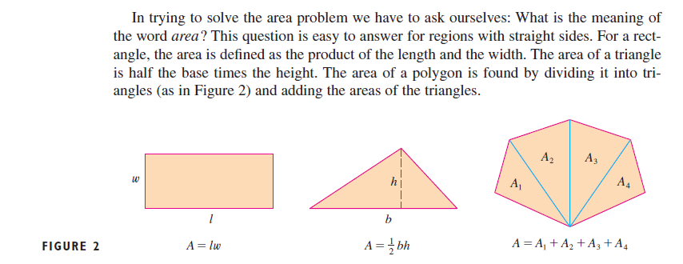

Slide 4
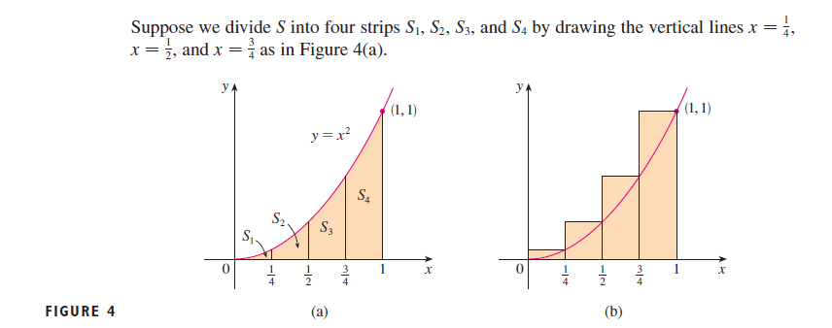

Slide 5
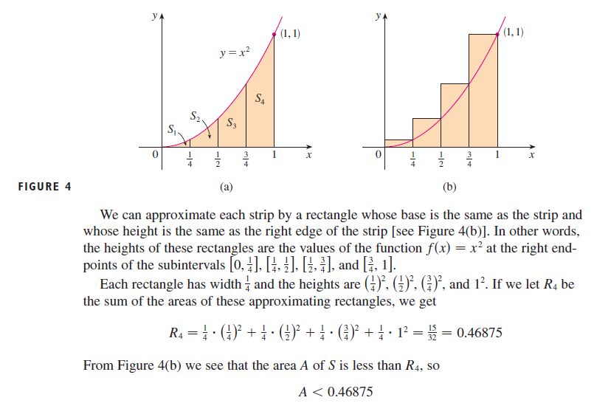

Slide 6
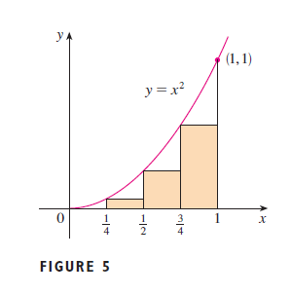

Slide 7
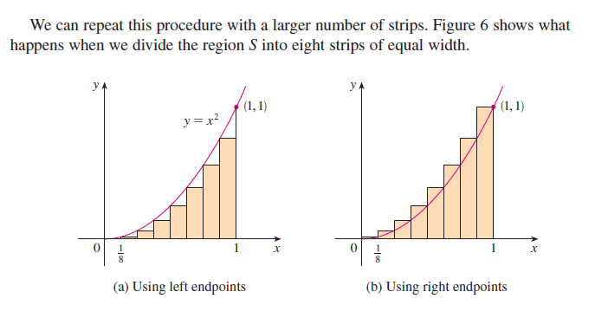

Slide 8
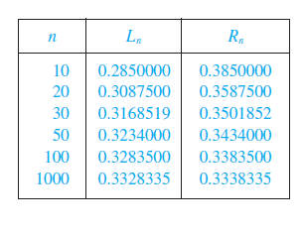

Slide 9
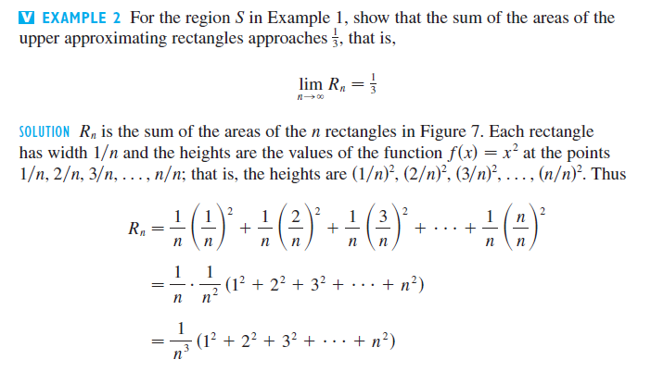
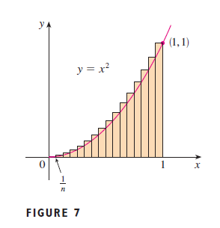

Slide 10
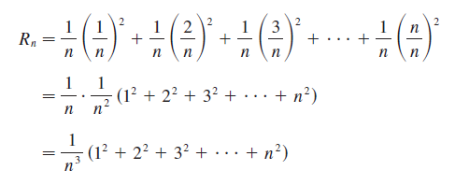

Slide 11
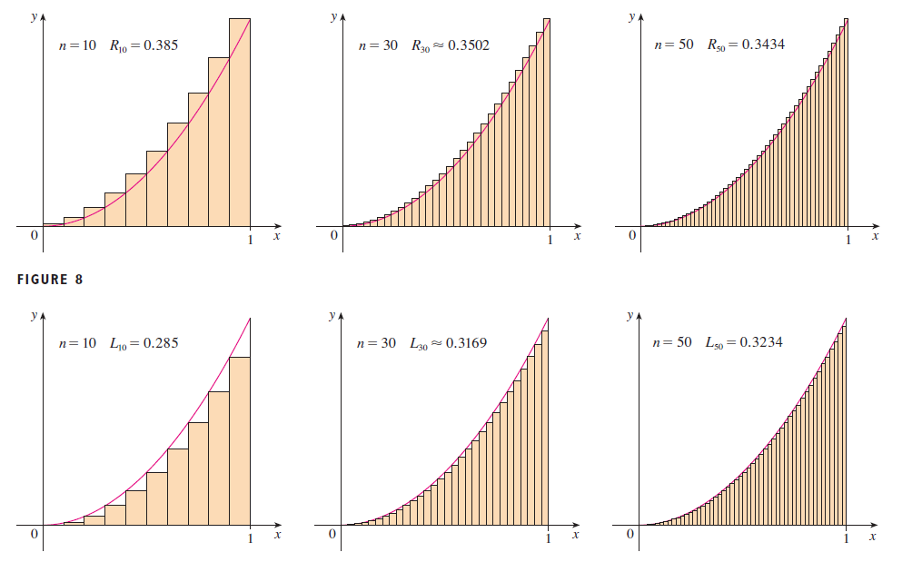

Slide 12
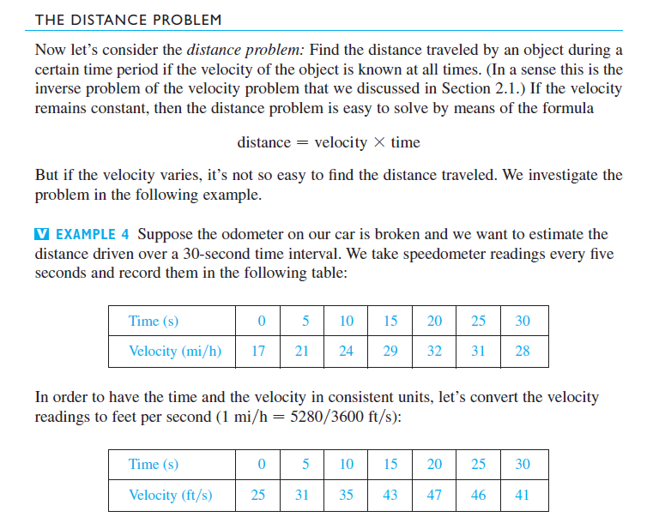

Slide 13
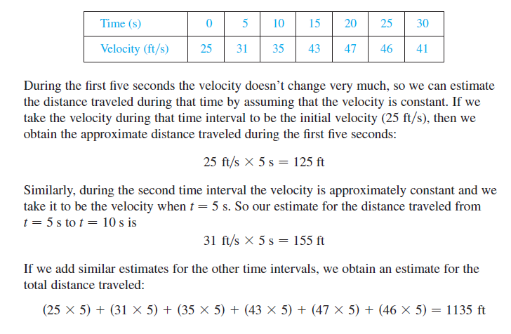
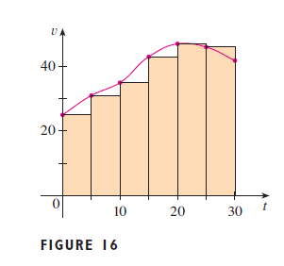

Slide 14
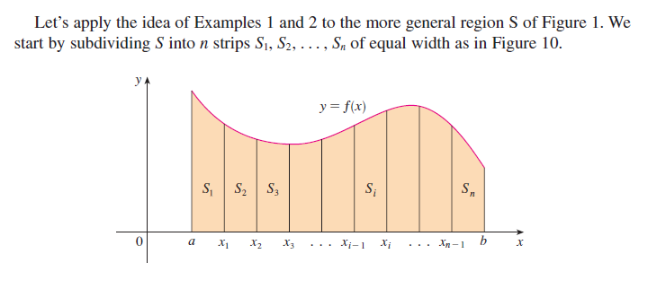
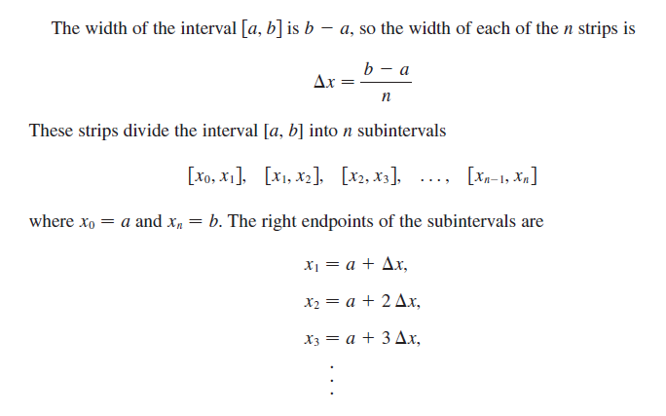

Slide 15
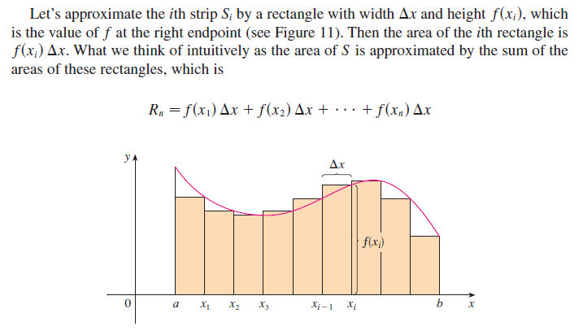
Note: Later on, we will learn that this sum is called a Riemann sum, after the brilliant German mathematician Bernhard Riemann.

Slide 16
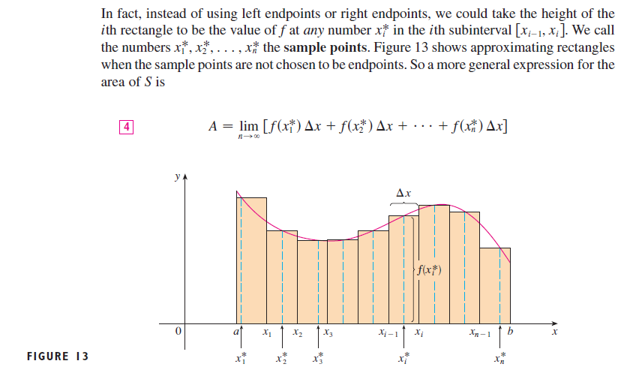

Slide 17
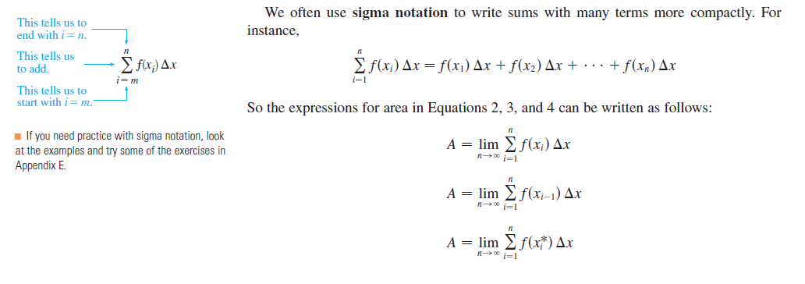

Slide 18
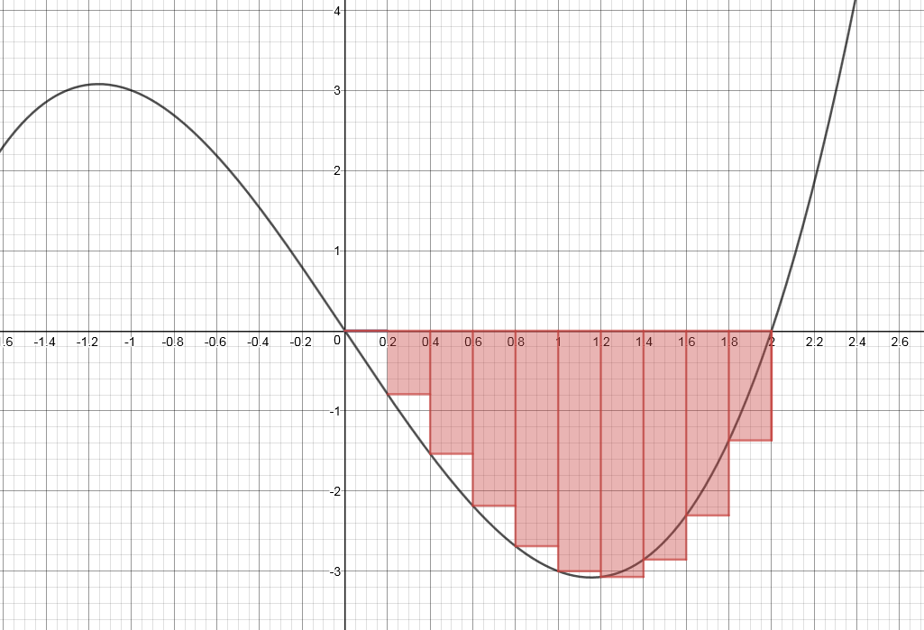
Example 5 Compute the area between the x-axis and the curve $x^{3}−4x$
from $x=0$ to $x=2$.
For 10 rectangles (i.e. n = 10), the left Riemann sum is
$$\frac{2}{10}\left\{\left(0^{3}−4∙0\right)+\left({0.2}^{3}−4\left(0.2\right)\right)+\left({0.4}^{3}−4\left(0.4\right)\right)+⋯+({1.8}^{3}−4\left(1.8\right))\right\}$$

Slide 19
We shall soon see that this sum is negative, because the graph is below the x-axis; and thus we need to take the absolute value if we want a positive area.
In the general case for n rectangles, the left Riemann sum is R_{n} = $$\frac{2}{n}\left\{\left(0^{3}−4∙0\right)+\left({(\frac{2}{n})}^{3}−4\left(\frac{2}{n}\right)\right)+\left({(\frac{4}{n})}^{3}−4\left(\frac{4}{n}\right)\right)+⋯+[({\frac{2\left(n−1\right)}{n})}^{3}−4\left(\frac{2\left(n−1\right)}{n}\right)]\right\}$$
The area of the region will then be the (absolute value of the) limit of the above sum as n goes to infinity.

Slide 20
R_{n} = $\frac{2}{n}\left\{\left(0^{3}−4∙0\right)+\left({(\frac{2}{n})}^{3}−4\left(\frac{2}{n}\right)\right)+\left({(\frac{4}{n})}^{3}−4\left(\frac{4}{n}\right)\right)+⋯+[({\frac{2\left(n−1\right)}{n})}^{3}−4\left(\frac{2\left(n−1\right)}{n}\right)]\right\}$
After simplifying,
R_{n} = $\frac{2}{n}\left\{{(\frac{2}{n})}^{3}+{(\frac{4}{n})}^{3}+{(\frac{6}{n})}^{3}+⋯+({\frac{2\left(n−1\right)}{n})}^{3}\right\}−\frac{2}{n}\left\{4\left(\frac{2}{n}\right)+4\left(\frac{4}{n}\right)+4\left(\frac{6}{n}\right)+⋯+4\left(\frac{2\left(n−1\right)}{n}\right)\right\}$
$=\frac{2}{n}∙{\left(\frac{2}{n}\right)}^{3}\left\{1^{3}+2^{3}+3^{3}+⋯+{\left(n−1\right)}^{3}\right\}−\frac{2}{n}∙4\left(\frac{2}{n}\right)\left\{1+2+3+⋯+\left(n−1\right)\right\}$
$=\frac{16}{n^{4}}∙\frac{{\left(n−1\right)}^{2}{∙n}^{2}}{4}−\frac{16}{n^{2}}∙\frac{\left(n−1\right)n}{2}$ $$=4\left[\frac{{\left(n−1\right)}^{2}}{n^{2}}\right]−8(\frac{n−1}{n})$$
Therefore Area = $\left|\lim_{n→∞}{R_{n}}\right|=\left|4−8\right|=4$

